Slide 1
Intro to R: Data Science & Visualization Session 1 : Intro in R
Prepared by \ Omnia Abdelnasser
Ta in giu

Slide 2

Introduction to R
R is one of the most used scripting programming languages especially in the area data science.
R is an environment in which you can perform statistical analysis and produce graphics.
R is free and available on any platform (Mac, PC, Linux, etc.) and also, via RStudio, in a web browser.

Slide 3
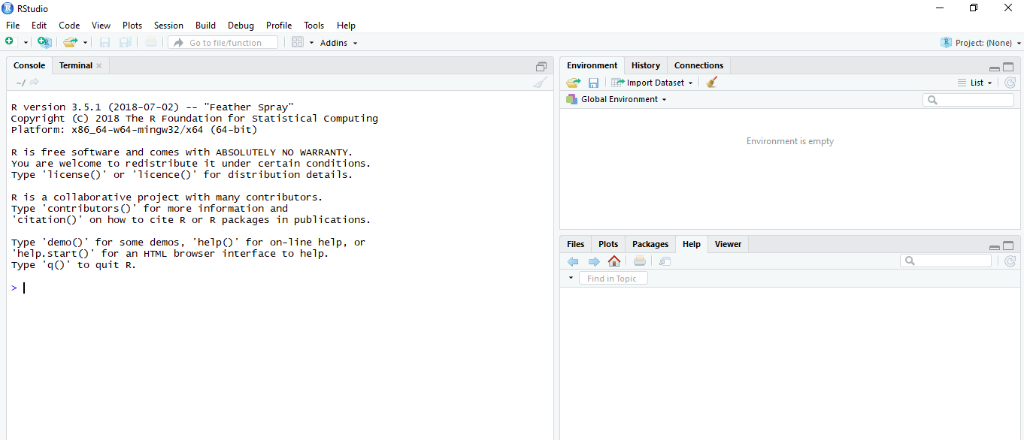
RStudio
Console :
- Directly execute R commands interactively

Slide 4
RStudio
Environment
• stores current variable / global variables
History
• History of the used R commands

Slide 5
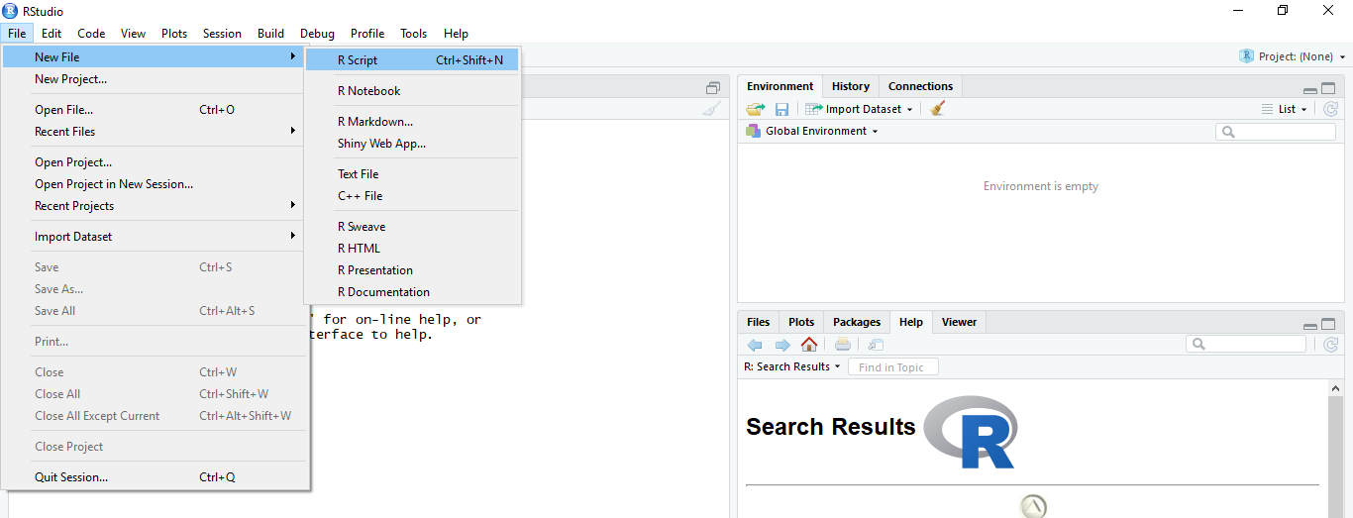
Making a new R Script

Slide 6
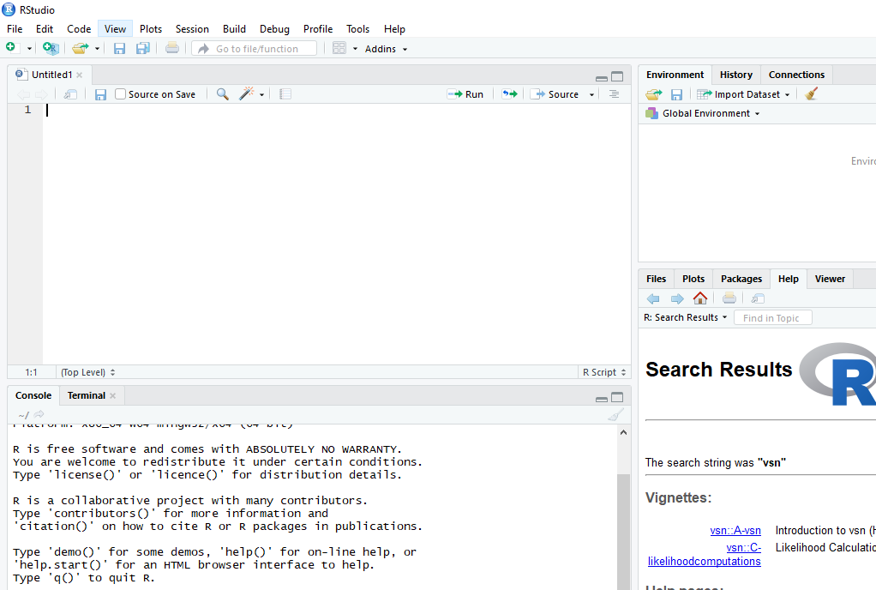
Making a new R Script
Script is R file at which you can write and save all your codes and execute at once

Slide 7
Simple calculations (Numbers)
At its most basic, R can be used as a simple calculator.
> 3+1
## [1] 4
> 2*2
## [1] 4
> sqrt(25)-1
## [1] 4

Slide 8
Simple calculations (using functions)
In R, arguments are provided to a function within the parenthesis -- ( ) -- that follows the function name. So sqrt(ARGUMENT) will provide the square root of the value of ARGUMENT.
Other examples of functions include min(), sum(), max().
Note multiple arguments are separated by a comma.
min(2,4,6)
## [1] 2
sum(2,4,6)
## [1] 12
max(2,4,6)
## [1] 6

Slide 9
Data Types
• numeric (double): real numbers; E.G. 5, 100, 1.01 (integers or floats)
• character: chain of characters, text; E.G. “GGTCAA”
• • logical: TRUE or FALSE; E.G. 2 == 2 the double equal sign (==) means does number 2 equal 2 then the answer will be TRUE

Slide 10
Variables
A variable is a symbolic name to which a value may be associated.
E.G;
DNA <- “GGTCAACTG”
Giving a new value to a variable is called assignment

Slide 11
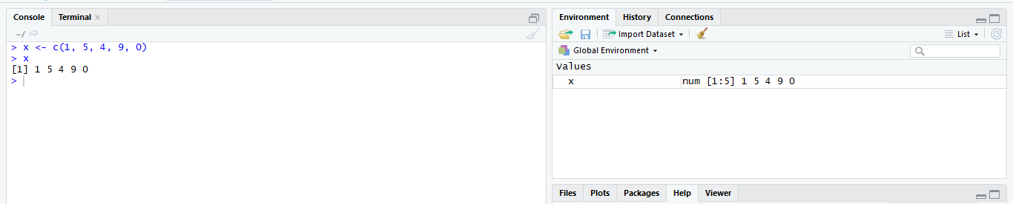
Vectors
A vector is an ordered group of elements (variables) of the same type with a single dimension.
The c(...) construct (concatenate or combine )can be used to create vectors:
E.g. x <- c(1, 5, 4, 9, 0)
X is a vector numerical values
C is a function to create a list

Slide 12
Vectors
Other useful function to create stretches of numeric vectors are seq() and rep().
The seq() function creates a sequence of numeric values from a specified start and end
value, incrementing by a user defined amount. The rep() function repeats a variable a user-
defined number of times.
seq(from=1,to=5,by=2)
## [1] 1 3 5
rep(c(1,5,10),3)
## [1] 1 5 10 1 5 10 1 5 10

Slide 13
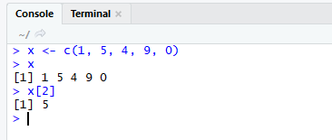
Vectors
To access vector elements, we use an index inside a single square bracket ("[]"):
X[2]
will give us value of 5
You can convert vectors to list using
as list function
as.list(x)

Slide 14
The unique() function
The unique() function can be used to retrieve all unique values
from a vector.
geneList <- c("Gene1","Gene2","Gene3","Gene4","Gene5","Gene1","Gene3")
unique(geneList)
## [1] "Gene1" "Gene2" "Gene3" "Gene4" "Gene5“
Also as done with numeric vector we can replicate a character vector:
RepGeneList <- paste0(rep(c("Gene"),10),seq(1,10,1))

Slide 15
The binary match operator (%in%)
A common task in R is to subset one vector by the values in another vector.
The %in% operator in the context A %in% B creates a logical vector of whether values in A matches
any values in of B. This can be then used to subset the values within one character vector by a those in a second.
geneList <- c("Gene1","Gene2","Gene3","Gene4","Gene5","Gene1","Gene3")
secondGeneList <- c("Gene5","Gene3")
logical_index <- geneList %in% secondGeneList
logical_index
## [1] FALSE FALSE TRUE FALSE TRUE FALSE TRUE
geneList[logical_index]
## [1] "Gene3" "Gene5" "Gene3"

Slide 16
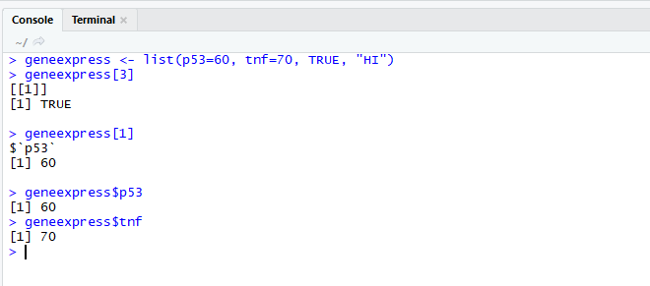
List
A list is a special type of vector. Each element can be a different type.
E.g. geneexpress <- list(p53=60, tnf=70, TRUE, “HI”)
Specific elements of a list can be accessed by writing the name of the list and then the $ character, followed by the name of the element (if any), or the square bracket "[]".

Slide 17
Matrices
A matrix is a multidimensional collection of data entries of the same type. Matrices have two dimensions. It has rownames and colnames according to the number of each 5 rows and 2 columns the matrix will has 10 dimensions (5*2)
matrices can be created with the function matrix :
A <- matrix(nrow=2, ncol=3, data=c(1,2,3,4,5,6))
You can add row by rbind function or column by cbind function
Number of rows
Number of columns

Slide 18
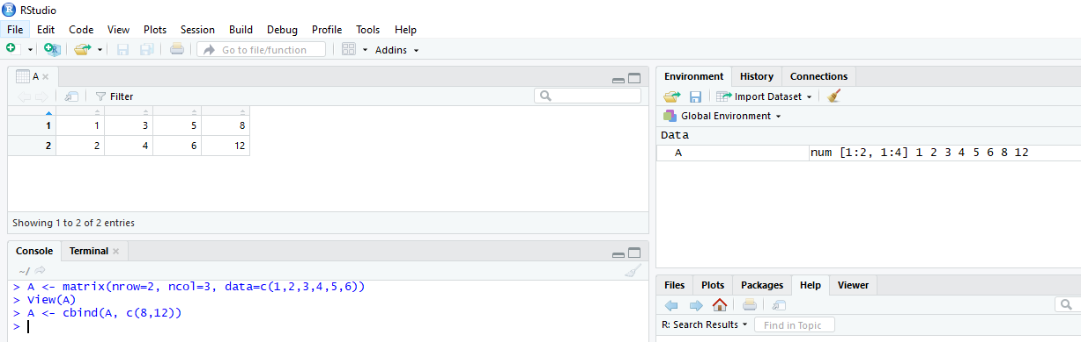
Matrices

Slide 19
Logical
LogicalMatrix <- matrix(c(T,T,T,T,T,F,F,F,F,F), nrow=2, ncol=5)
• Character:CharacterMatrix <- matrix(c("a","b","c","d","e","f","g","h","i","j"), nrow=2,ncol=5)
• Integer (called numeric):IntegerMatrix <- matrix(1:10), nrow=2, ncol=5)
• double (called numeric):doubleMatrix <- matrix(seq(0.5,9.5,1)), nrow=2, ncol=5)

Slide 20
Matrices (Finding dimensions)
To find dimensions of a matrix, the dim() function will provide dimensions as the row
then column number while nrow() and ncol() will return just row number and column
number respectively.
dim(IntegerMatrix )
## [1] 5 2
nrow(IntegerMatrix )
## [1] 5
ncol(IntegerMatrix )
## [1] 2

Slide 21
Matrices (Indexing)
• Selecting and replacing portions of a matrix can be done
by indexing using square brackets [] much like for vectors.
• When indexing matrices, two values may be provided within the
square brackets separated by a comma to retrieve information on a
matrix position.
• The first value(s) corresponds to row(s) and the second to column(s).
• myMatrix[rowOfInterest,columnOfInterest]

Slide 22
Matrices (Column and row names)
As we have seen with vectors, matrices can be named. For matrices the
naming is done by columns and rows
using colnames() and rownames() functions.
namedMatrix <- matrix(1:10,ncol=5,nrow=2)
colnames(namedMatrix) <- paste("Column",1:5,sep="_")
rownames(namedMatrix) <- paste("Row",1:2,sep="_")
namedMatrix
## Column_1 Column_2 Column_3 Column_4 Column_5
## Row_1 1 3 5 7 9
## Row_2 2 4 6 8 10

Slide 23
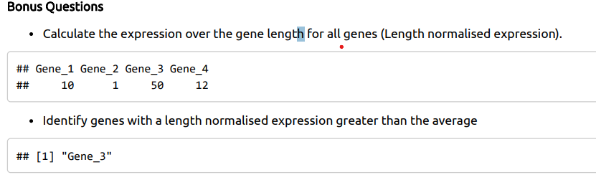
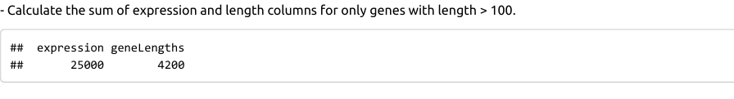
Assignment

